Slide 1


Machine Learning
With python
intro: welcome!
Introduction to the course, website, syllabus
Notes:
Layout objects pulled from: https://slidesgo.com/
All icons are from: https://thenounproject.com/

Slide 2

Write name in CAPS + BIG font, need to see this from across the room.
To make sure you don’t lose this, at the end of class place it in a stack on the front table
Why do this?
So both instructor and table mates can learn your name.
We use these during work time to indicate progress through concepts

Slide 3
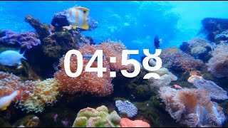
Warm-up
Get into groups of 2 and find a spot on a board.
For each of the following, give your best guess at defining the term and giving some application examples:
Machine Learning (ML) Artificial Intelligence (AI)
How is this different from traditional programming?

Slide 4
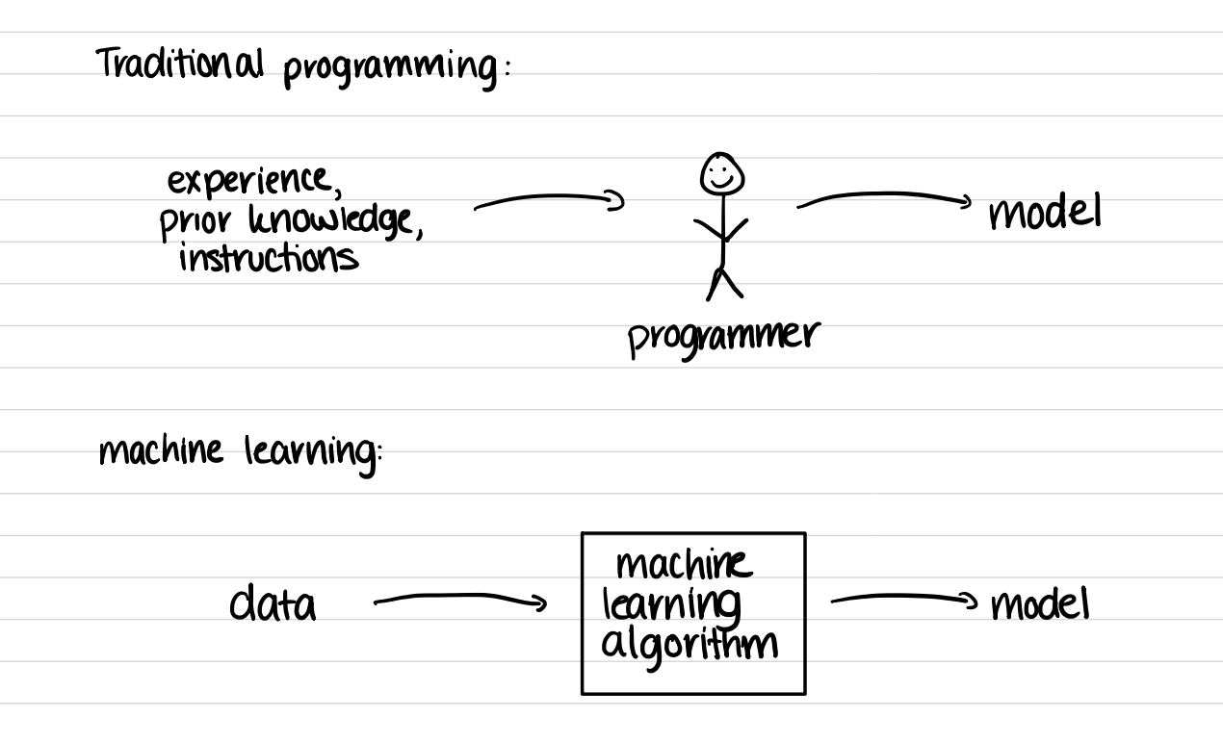

Slide 5
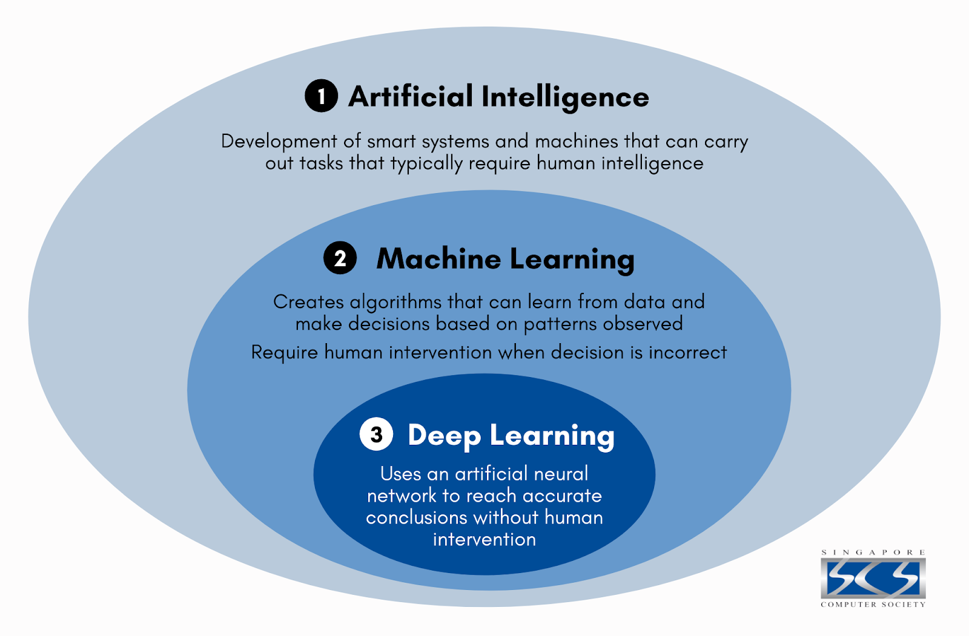
ML is quite practical by:
reducing programming time,
allowing customizable and scalable code as a product,
coding unprogrammable tasks

Slide 6
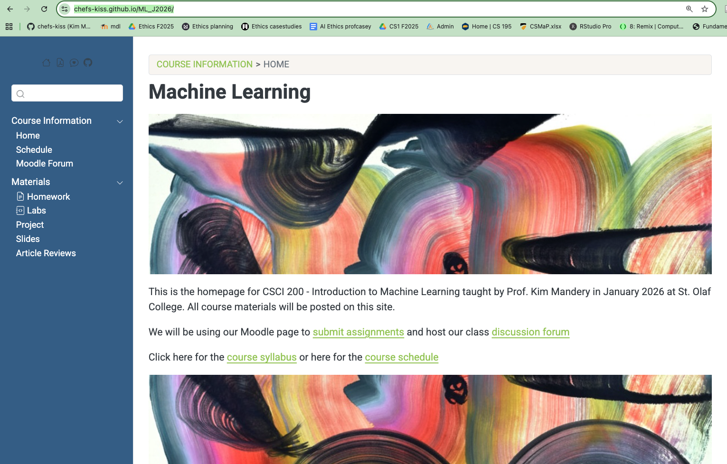
chefs-kiss.github.io/ML_J2026/
This is our course site!
All content including slides, labs, homework, syllabus are on this site.
We will use Moodle for class discussion, turning in assignments, and a gradebook.

Slide 7
scavenger hunt
Grab a partner. Using the course website, answer the following questions:
We will use being using the Moodle forum periodically for classroom discussion. Find a way to get to the Moodle forum from the course site, and post a reply under “Favorite emoji”.
Find and open at least two cheat sheets for common Python libraries found under the EDA readings.
Find the readings for the EVL topic we’ll be covering at the end of this week, and browse some of the excerpts.
The topics of this course are built off ACM Standards. Go to the syllabus and find the standards related to Algorithms.
Read the attendance policy on the syllabus. What does an absence mean in terms of our Jterm course?
What is one additional question that you would like to know about this course?
When you are get to Question 8, flip your name cards down.

Slide 8
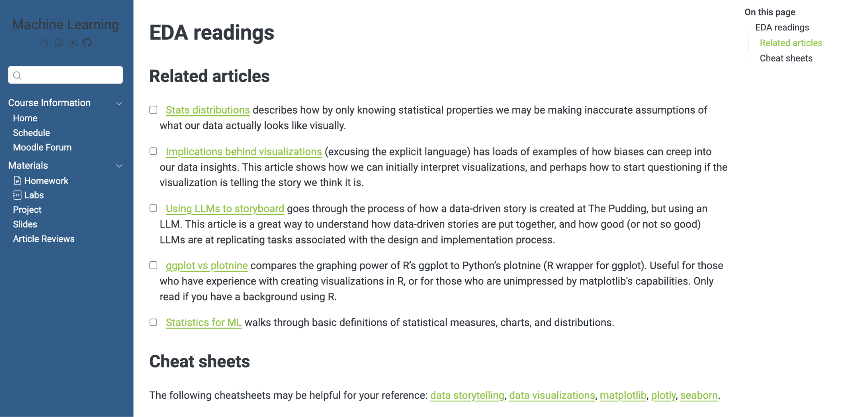
A note on readings
Due to J-term turn around, these readings are never due HOWEVER…
these articles and passages from the textbook WILL help you understand the material. Let’s take a peak at this in particular

Slide 9
standards
quiz + exams
For every topic we will have a quiz that contains 3-4 questions, each question assessing your understanding of one topic. These questions are called standards.
There will be 16 standards in total. You can study for these by reviewing slide decks, workbooks, homework, and programming assignments. Sample questions will be available on the course site.
Grading for these are in the syllabus. Revisions are due the following class day.
If you will miss a quiz or do not pass the first time, you will retake it during the next retake period (see schedule)

Slide 10
passing off others work as your own
assignments + plagiarism
What counts as plagiarism? …well anything that you didn’t come up with yourself.
It is encouraged to work with others on assignments, but you need to cite (i.e. leave a comment somewhere) who helped you. This can be another student, roommate, teammate, TA, friend, family member...
What about using generative models (ChatGPT, DeepSeek) or searching the internet?
You must cite which model you use, as well as the prompt. We will often use these models under a critical lens. If you have any concerns please let me know.
Any labs with plagiarism will be graded as a 0. Make sure to cite and document when you use outside tools (including any prompts used).

Slide 11
Machine Learning
With python
PC 1
Finding Datasets of Interest
Notes:
Layout objects pulled from: https://slidesgo.com/
All icons are from: https://thenounproject.com/

Slide 12
discussion
Chat with your partner:
Where can you find interesting data sources?

Slide 13
Machine Learning
With python
lab 1
Dictionaries and Policing Data
Notes:
Layout objects pulled from: https://slidesgo.com/
All icons are from: https://thenounproject.com/

Slide 14
lab time!
Let’s get into lab groups.
Find a partner (you’ll get a new one next week!) and designate one partner to be the recorder (writes the code) and one to be the researcher (sifts through slides and/or documentation).
If you are the recorder:
Find Lab 0 on the course site.
Open the link to the Colab workbook.
Save a copy as Last1_Last2_Lab1 replacing the last names with recorder and researcher respectively.
Share access -> St Olaf.
Make sure the researcher has a link to the workbook.

Slide 15

lab time!
Let’s walk through how to use Colab workbooks and go over Question #1 together.
When it comes time to work in your groups, the researcher may find it useful to have the Python documentation open on dictionaries.
As questions arise, try to work out solutions together. If you are both stumped, let Prof Kim know.
Break for lunch at 12:30, afternoon sessions starts at 1:30

